Slide 1
Forms
Front-End Web Development

Slide 2
Lesson 15 Change Log FEWD 3.1 - 3.2
Below are the specific changes made in this lesson.
Returning Instructor Directions:
Click on the hyperlinks below, and it will direct you to the specific slide.
Copy the entire slide, and paste in your existing curriculum deck.
Pre-Class Materials and Preparation -
Added warmup activities to the new CodePen collection “Warmups”.
Added two new CodePens — JS Form Validation and Calculator — to Starter and Solution Code.
Share how the lesson went through our Instructor Lesson Exit Ticket - the Curriculum Feedback form: http://ga.co/curriculum-feedback

Slide 3
Pre-Class Materials and Preparation
Review all slides, lab activities, and code-alongs.
There are prompts in the speaker notes with opportunities for instructor customization.
Materials:
Reference Code
Starter Code in CodePen
Solution Code in CodePen
Warmups in CodePen

Slide 4
Forms
Overview
This lesson introduces HTML forms and how JS can be used to collect and validate information from users.
Learning Objectives
In this lesson, students will:
Use HTML forms to collect input from users.
Respond to form submission events to perform validation checks.
Duration: 180 minutes

Slide 5
Suggested Agenda
Time | Activity | Purpose
0:00–0:30 | Forms Reference | Introduce the structure of HTML forms.
0:30–1:00 | Types of Inputs and Styling Forms | Briefly cover the most popular types of inputs and how forms should (and shouldn't) be styled.
1:00–1:30 | Styling Forms | Groups apply and demonstrate forms and styling based on real examples.
1:45–2:15 | Validating Form Submissions | Practical examples of how forms and DOM manipulation create user experience.
2:15–3:00 | Form Submissions Exercise

Slide 6
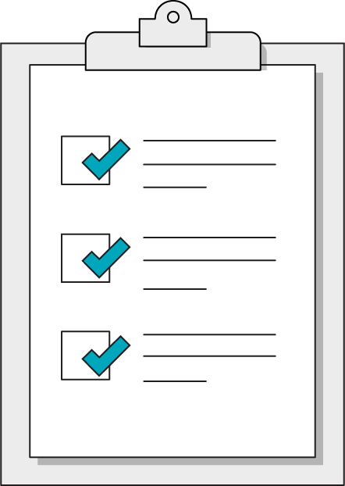
Today’s Learning Objectives
In this lesson, you will:
Use HTML forms to collect input from users.
Respond to form submission events to perform validation checks.
‹#› | © 2020 General Assembly
Notes:
DURATION: 1 minute
TEACHING TIPS:
Learning objectives help frame the lesson and give students an idea of what to expect and focus on.
Explain to students how this lesson fits into the overall course to help them make connections with content from other lessons.

Slide 7
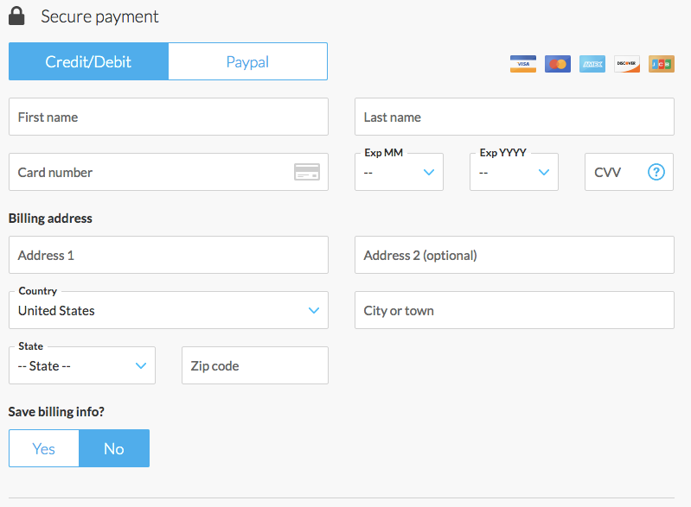
Websites Take on Many Forms...
Notes:
TALKING POINTS:
So far, we’ve looked at interaction from users with a limited amount of possibilities. Either they click something or they don’t. Forms let users perform more complex interactions, allowing them to put in their own data.

Slide 8
Forms Reference
Reference the HTML for forms in the following CodePen:
Reference code:
https://codepen.io/GAmarketing/pen/592d34e48473087e5444d4dad31af7d2

Slide 9

What Forms Do
Forms capture user input from the web and typically send it off to the back-end of a website to be processed in some way.
Anytime you enter any content into a webpage, you are using a form!
Notes:
TALKING POINTS:
We’ll look at the API/submissions process in more depth in the next lesson. For now, think of form submissions as the phone calls of the internet.

Slide 10
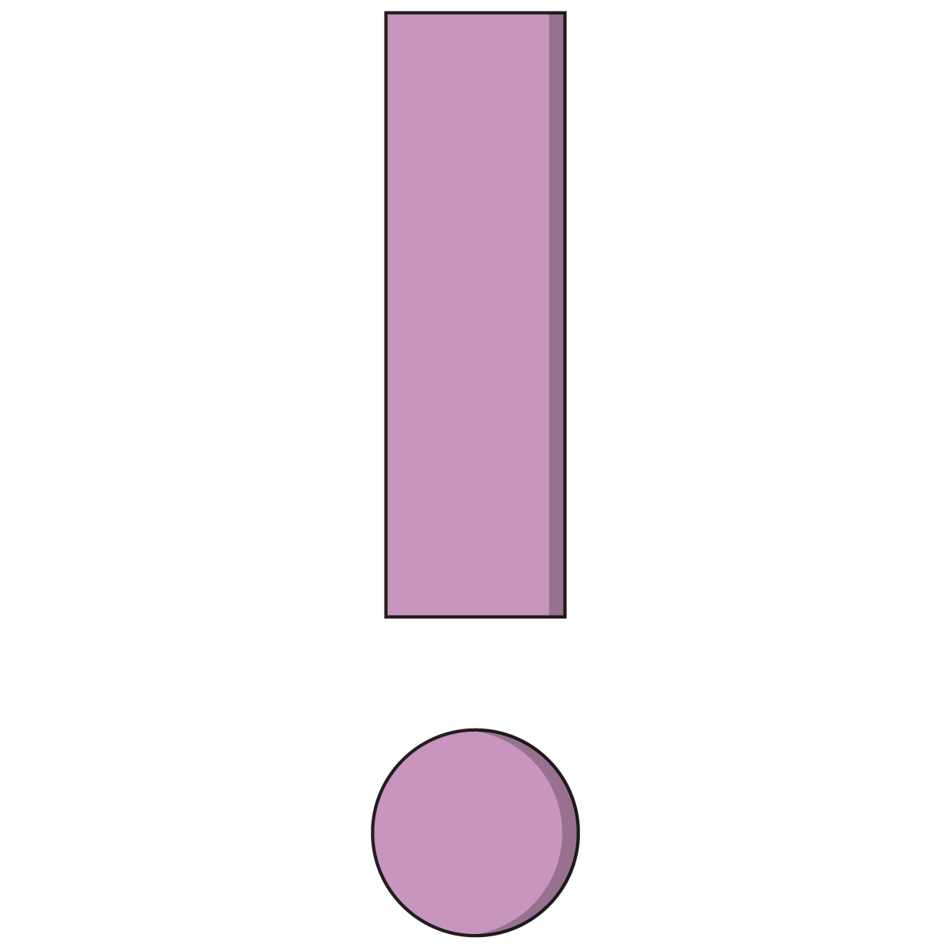
Simplest Form
<form action="/process.php" method="get">
<input type="text">
<input type="submit">
</form>
All forms have the form tag wrapping around them. Always include all components of your form within these tags.
Forms have a lot of markup and are tedious to build.
Notes:
TALKING POINTS:
For instance, normalize.css spends most of its energy taming form inputs. There are also many different styles and patterns of forms out there, so don’t expect a one-true-way of creating forms! Just focus on the essentials: <form>, inputs, and submit.

Slide 11
The Form Element
<form action="/process.php" method="get">
<input type="text">
<input type="submit">
</form>
Action
The action is where the data of the form will be sent (assuming JavaScript is not involved)
Method
This is either “get” or “post” and governs how the browser sends the data to the target listed in the action.
Notes:
TALKING POINTS:

Slide 12
<input>
<form action="/process.php" method="get">
<fieldset>
<legend>Form Title</legend>
<input type="text" id="username">
<input type=”number” id=”age”>
<input type=”submit” value=”Submit this form!”>
</fieldset>
</form>
Notes:
TALKING POINTS:
input is the workhorse of the form world — it can accept many types of user information, depending on the type property it is given.

Slide 13
<label>
<form action="/process.php" method="get">
<fieldset>
<legend>Form Title</legend>
<label for="username">Username:</label>
<input type="text" id="username">
<button type="submit">
</fieldset>
</form>
Notes:
TALKING POINTS:
label is the tag for telling a user what an input represents. The for attribute specifies which form element a label is bound to and uses the element’s id value as its means of making this distinction. The relationship provides some UI features such as moving focus to the relevant input when the label is clicked, tapped, or otherwise triggered.

Slide 14
Ready, <fieldset>, Go!
<form action="/process.php" method="get">
<fieldset>
<input type="text">
<button type="submit">
</fieldset>
</form>
Notes:
TALKING POINTS:
<fieldset> wraps around a set of field inputs on the form. These tags are optional but semantically useful for forms with complex presentation.
Here is a working example of a <fieldset>: https://www.w3schools.com/tags/tag_fieldset.asp

Slide 15
Life of a <legend>
<form action="/process.php" method="get">
<fieldset>
<legend>Form Title</legend>
<input type="text">
<button type="submit">
</fieldset>
</form>
Notes:
TALKING POINTS:
<legend> is where you can put the title of the form or <fieldset>.

Slide 16
Types of Inputs
Front-End Web Development

Slide 17

The Wide, Wide World of Input Types
There’s a huge list of possible input types out there: https://developer.mozilla.org/en-US/docs/Web/HTML/Element/input
Depending on how specific you want to get, the same form question could be represented with several different form inputs.
Once again, the world of programming presents us with a large number of possibilities. Like usual, we’ll focus in on a few of the most important items that will allow us to master the patterns that will show up for all other types of inputs.

Slide 18
text and number Inputs
<form>
<fieldset>
<legend>Form Title</legend>
<input type="text" id="username">
<input type="number" id="age">
<input type="submit" value="Submit this form!">
</fieldset>
</form>
Data gathered with JavaScript from a number input will be in the form of a string! You may have to typecast the value into a number type.
Notes:
TALKING POINTS:
The most common inputs, text and number, are self-explanatory.

Slide 19
<textarea>
<textarea placeholder="Write something here"></textarea>
This creates a really big area of text that users can fill in. Although you may see this done in examples, don't size it with HTML attributes — please use CSS!

Slide 20
<select>
<select id="plays-of-shakespeare">
<optgroup label="Dramas">
<option value=”king-lear”>King Lear</option>
<option value=”hamlet”>Hamlet</option>
</optgroup>
<optgroup label="Comedy">
<option value=”midsummer”>A Midsummer Night’s Dream</option>
<option value=”twelfth-night”>Twelfth Night</option>
</optgroup>
</select>
select is for lists you click on to select an item.
optgroup is optional but useful for grouping related options.
option is an individual value a user can choose from the select list.

Slide 21
Checkboxes
<div class="checkbox">
<input type="checkbox" id="vip-upgrade">
<label for="vip-upgrade">VIP upgrade</label>
</div>
checkbox inputs can either be “on” or “off,” depending on whether the user has clicked them.
You have to put labels after checkboxes for them to make any sense, otherwise they’re just floating squares in your form.

Slide 22
Radio Buttons
<div class="radio">
<input type="radio" id="radio1" name="quality-feedback">
<label for="radio1"><span>Good</span></label>
</div>
<div class="radio">
<input type="radio" id="radio2" name="quality-feedback">
<label for="radio2"><span>Bad</span></label>
</div>
Radio buttons are very similar to checkboxes but function as a group with the name attribute. Users can only choose one option among radio inputs with the same name.

Slide 23
Styling Forms
Front-End Web Development

Slide 24
New CSS Selector: Attributes
input[type=text] {
margin: 25px 0;
}
input[type="text"] {
margin: 25px 0;
}
Notes:
TALKING POINTS:
If you want to target a particular attribute in HTML, use the brackets. The attribute name is on the left, and the specific value we want to target is on the right. Note that this pseudo-selector could use any HTML attribute, not just type!

Slide 25
:focus
textarea:focus {
outline: none;
}
There may be cases where you want to style what it looks like when a user is active on a field. To do so, use the :focus pseudo-selector.
Notes:
TEACHING TIPS:
Ask: Does this pseudo-selector remind you of anything we’ve seen before?
Answer: This should remind students of :hover from the animations lesson. A good point to remind them of is that, in web development, patterns are more useful than memorizing individual details.

Slide 26

Styling Notes
Don’t
Do
Style the text boxes, checkboxes, and radio buttons themselves. You can do this, but the techniques will drive you crazy.
Clutter the form with too many images or animations. Forms are supposed to make interactions with web applications simple and clear.
Put effort into styling valid vs. invalid form submission states. Help your users by clearly communicating when a form is invalid and which fields need to be fixed.

Slide 27
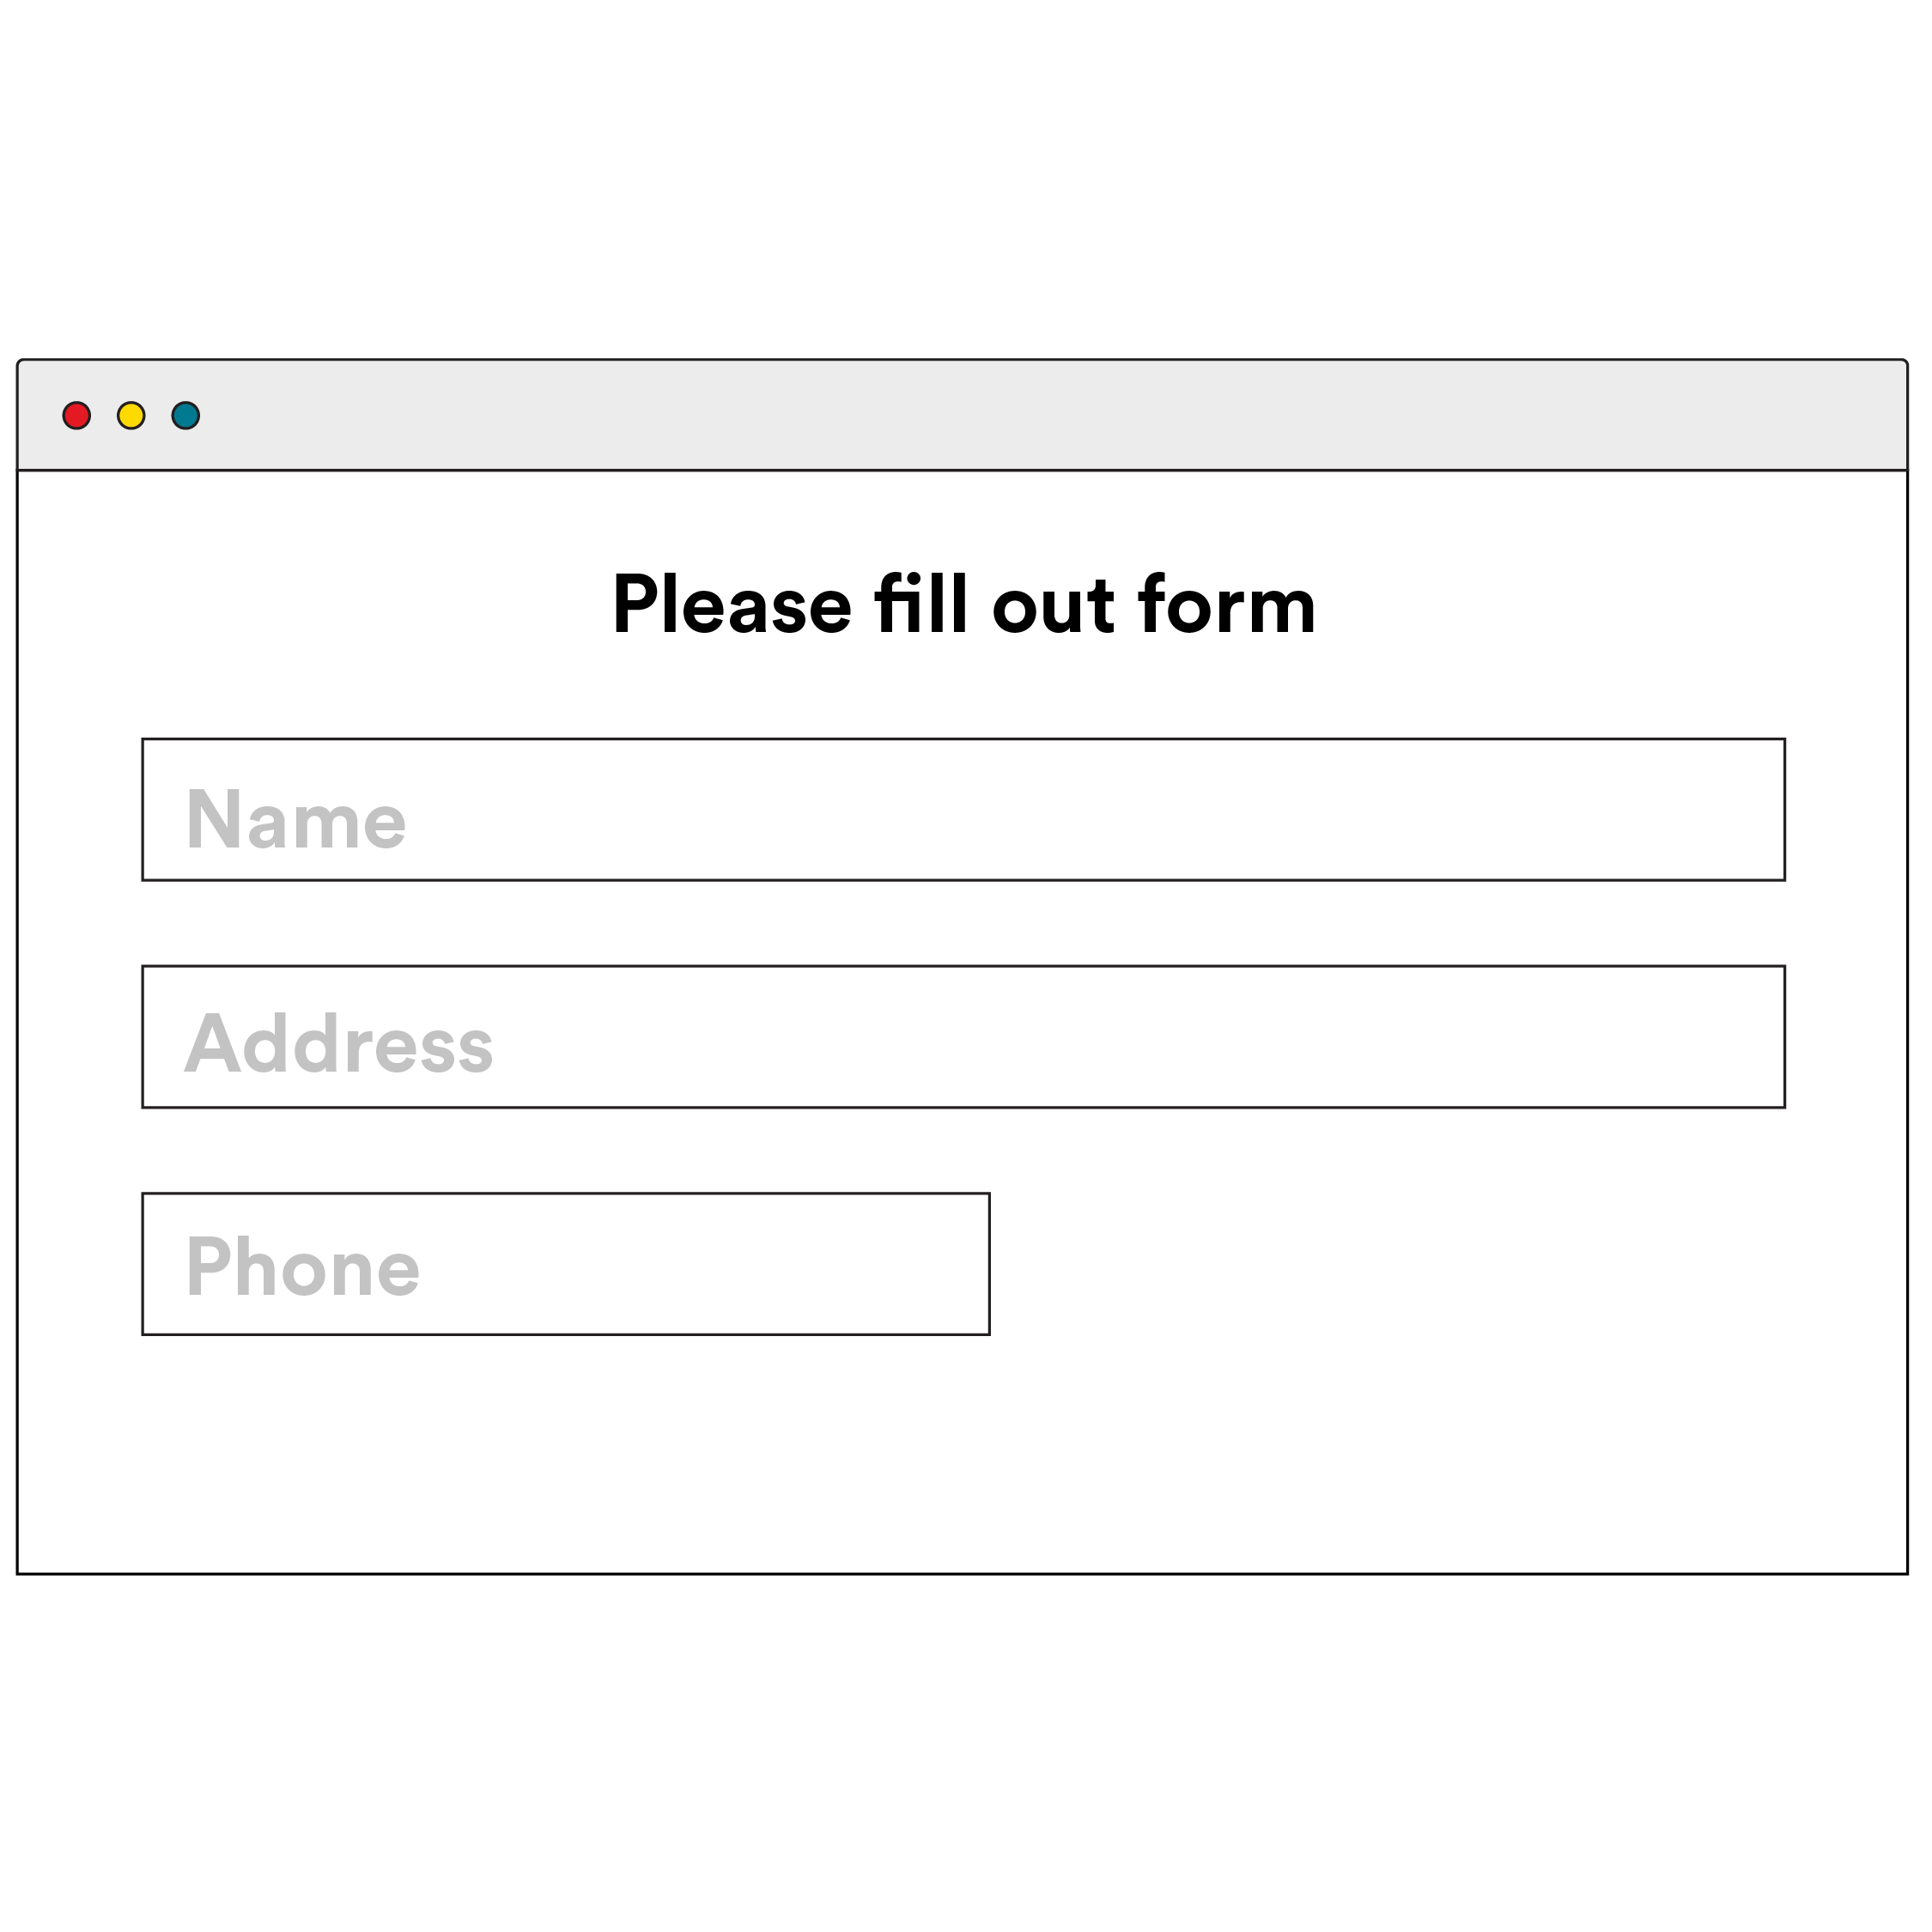
Registration Form
30 minutes
Choose one of your favorite websites and take a look at its registration form for new users. In groups, try recreating the HTML and style of the form. The more types of inputs, the better!
Notes:
TEACHING TIPS:
Have groups demonstrate their work after the exercise to share what they learned from their specific example.

Slide 28
Building & Styling A Form
Let’s use this form as an example for responding to a form submission:
Reference code:
https://drive.google.com/drive/folders/13zp3iDPROk1ZRfq6yOYxeKxnFxfFikeG?usp=sharing
‹#› | © 2020 General Assembly
Notes:
TEACHING TIPS:
Walk through the steps in the following slides in this CodePen, showing the process of stopping the form submission from firing, reading the information from the first field or two, and then appending an error message/clearing previous error messages.

Slide 29
Forms & Frameworks
Front-End Web Development

Slide 30
Frameworks Make Forms Easier
Frameworks provide:
Pre-styled form elements.
Better layout combinations
Small style helpers
Responsive form layout
‹#› | © 2020 General Assembly

Slide 31
Forms with Bootstrap
Let’s use this form as an example for responding to a form submission:
Reference code:
https://drive.google.com/drive/folders/15FkHZP8sQSNj09BqAKJNm9Ef_RzkhJwW?usp=sharing
‹#› | © 2020 General Assembly
Notes:
TEACHING TIPS:
Walk through the steps in the following slides in this CodePen, showing the process of stopping the form submission from firing, reading the information from the first field or two, and then appending an error message/clearing previous error messages.

Slide 32
Validating Form Submissions
Front-End Web Development

Slide 33
Responding to Form Submissions
Let’s use this form as an example for responding to a form submission:
Reference code:
https://codepen.io/GAmarketing/pen/GRgvqOM
‹#› | © 2020 General Assembly
Notes:
TEACHING TIPS:
Walk through the steps in the following slides in this CodePen, showing the process of stopping the form submission from firing, reading the information from the first field or two, and then appending an error message/clearing previous error messages.

Slide 34
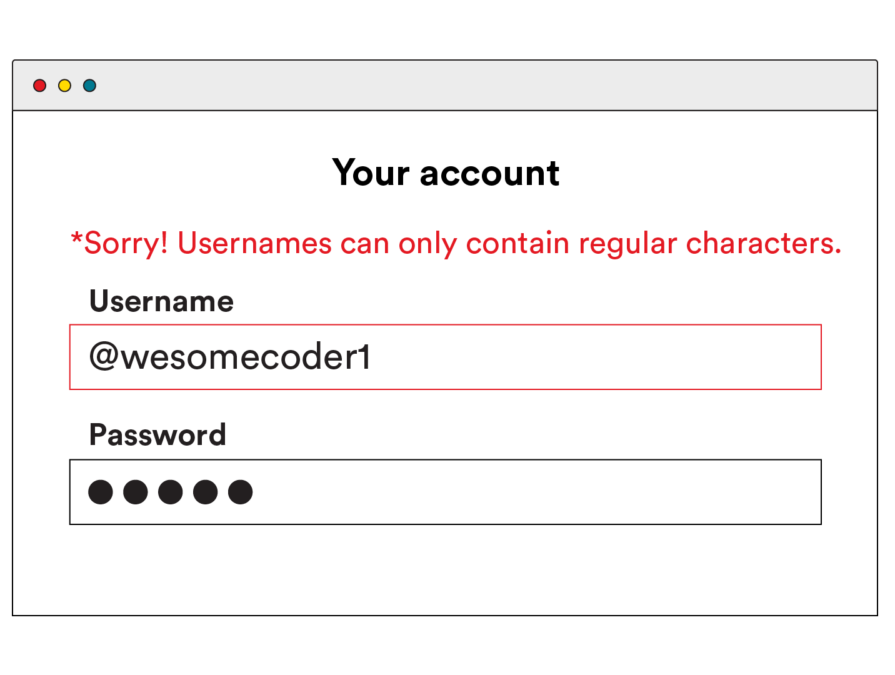
Validating Form Submissions
We’re going to break down how this happens in the next few slides by:
Responding to the “submit” event from a form.
Using the DOM to access the value a user has typed into an input.
Using DOM manipulation to add error messages to the page.

Slide 35
Responding to the submit Event
Remember, nearly any user action triggers an event from the DOM. It’s up to us to attach a listener to the specific DOM element that fires off the event. Let’s grab that element from the DOM and use the addEventListener() method:
document.getElementById(“#registrationForm”).addEventListener(“submit”,
function(event){
// event.preventDefault() prevents the browser from refreshing
event.preventDefault();
}
);
Notes:
TEACHING TIPS:
If you haven’t yet explained the event object in event listeners, now is the time. Properties like e.currentTarget and e.currentTarget.value will be particularly useful in the context of forms.

Slide 36
Reading the Form Content
We can use the .value getter method to access the value of an input field...
document.getElementById(“#registrationUserName”).value
...then, we can test that value for anything we want!
if(username.length < 3){
// Show an error message on the DOM
}

Slide 37

Displaying Error Messages
Think about most error messages you’ve seen from forms. Chances are they were displayed close to the input with the invalid value or beneath the form itself, if the problem was more general. You can do this several ways:
You could have an empty, hidden element for errors that gets shown or filled in once the error occurs.
You could append a new element to the DOM then remove it upon resubmission of the form.
You could use an alert box — though this is a bit old fashioned.

Slide 38
Form Submissions
60 minutes
Add validations and error messages for fields in this example form:
Starter code:
https://codepen.io/GAmarketing/pen/GRgvqOM
Notes:
TEACHING TIPS:
Note: There are many ways and validations students could choose to use here.

Slide 39
Key Takeaways
For Next Time
Forms Power User Interaction
APIs
Forms have many types of inputs.
CSS attribute selectors can target specific types of inputs.
We can respond to form submissions using event listeners.
We’ll use forms to collect data from users and use that data to make requests to other servers.
Our apps will finally interact with other members of the internet community: APIs!
‹#› | © 2020 General Assembly

